Slide 1
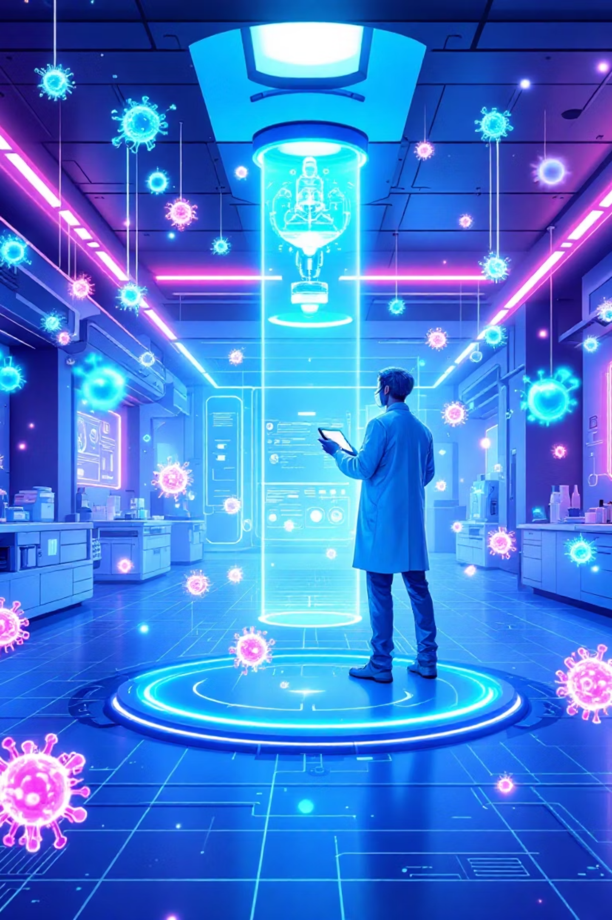
Precision Vaccine System Using AI & Machine Learning
The Future of Personalized Vaccination

Slide 2

Problem Statement: One-Size-Fits-All Vaccines
Current Limitations
Varied Responses
Vaccines are often "one-size-fits-all," ignoring individuals having different complications.
Patients exhibit diverse immune responses to standard vaccinations.
Risks Involved
The Need
This leads to adverse reactions or poor vaccine efficacy.
A personalized vaccination approach is crucial for different physiological conditions.

Slide 3





Step 1: Patient Data Collection
Gathering comprehensive data to create a personal immune fingerprint.
Medical History
Diabetes, HTN, asthma, allergies, autoimmune disease.
Previous Reactions
Severity of past vaccine adverse drug reactions (ADR).
Immune Biomarkers
Antibody levels, inflammatory markers.
Demographics
Age, sex, ethnicity.

Slide 4
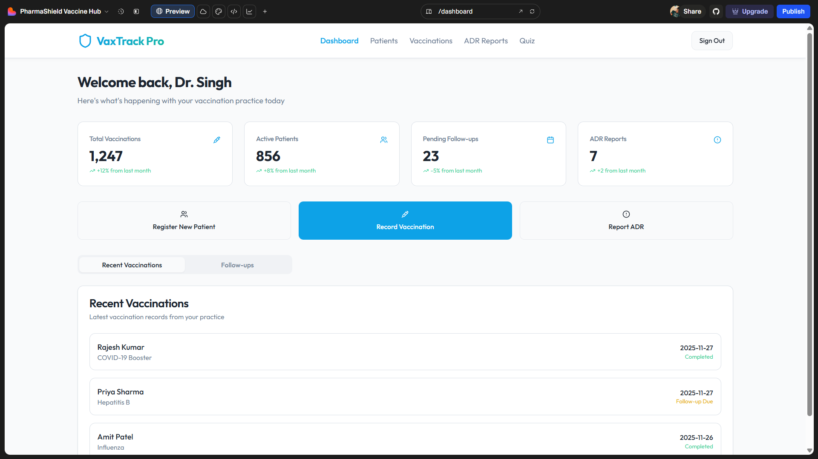

Slide 5
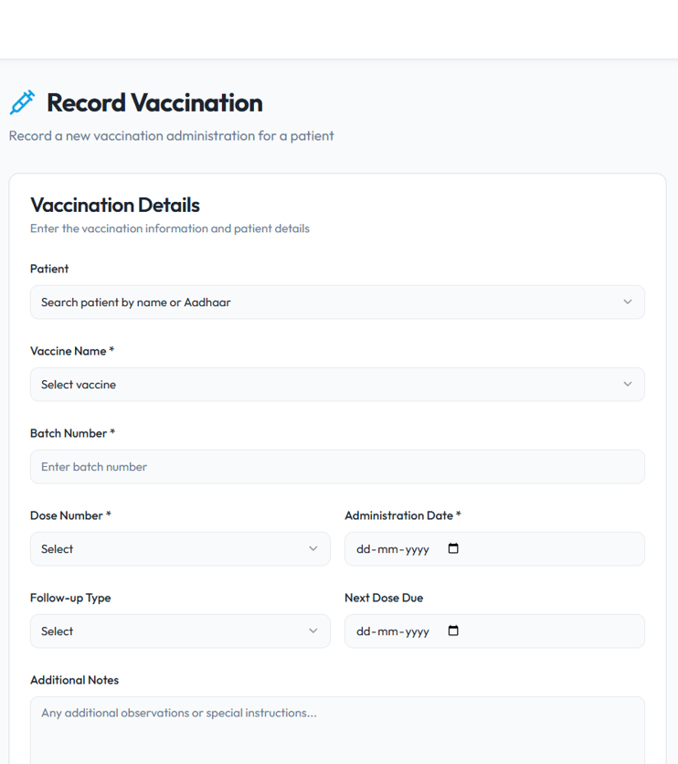
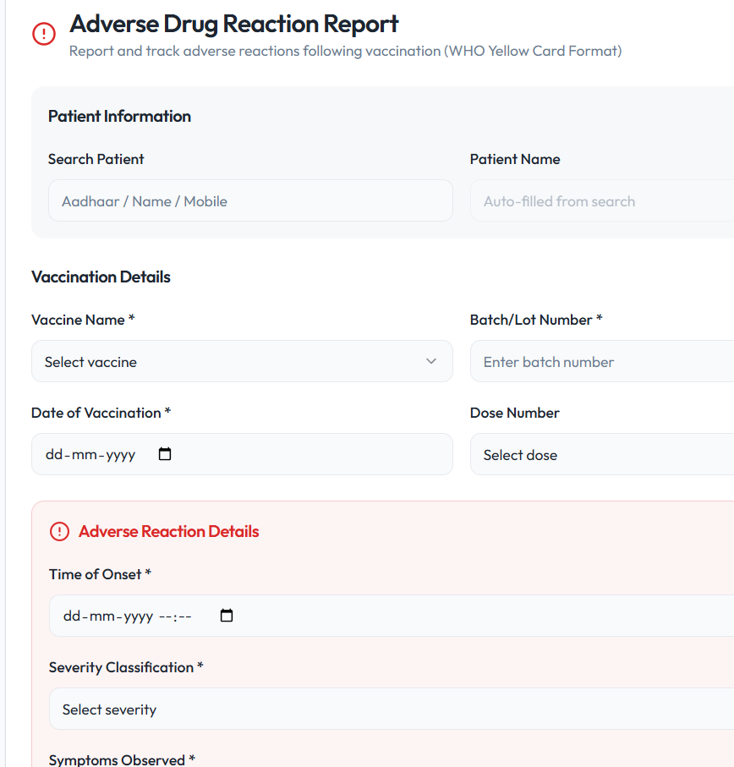

Slide 6


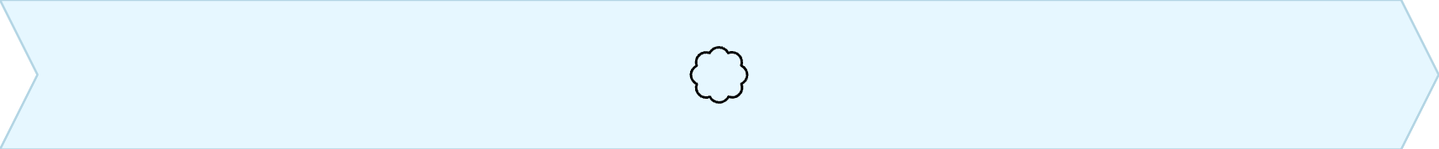
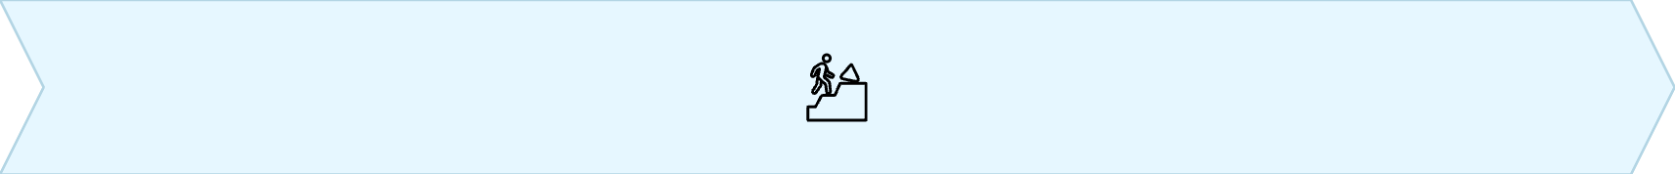
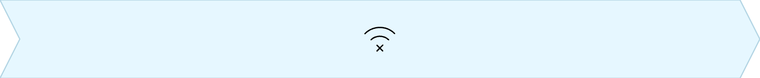
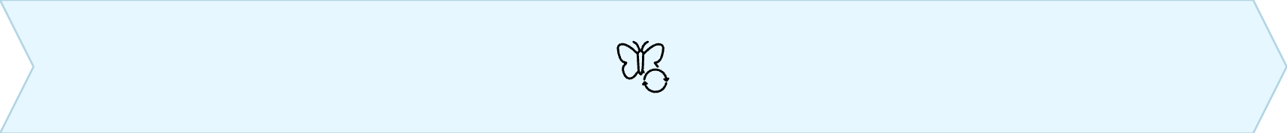
Step 2: AI + Machine Learning Analysis
AI and ML analyze vast population data to identify immune response categories.
Immune Patterns
ADR Risk Groups
Identify common immune response patterns.
Pinpoint groups at higher risk of adverse reactions.
Weak Immunity
Modified Needs
Predictors for individuals with weaker immune responses.
Groups requiring specially modified vaccines.

Slide 7
Immune Response Clusters
Categorizing patients for tailored vaccine strategies.
🟢 A: Normal
Healthy 18–50
Standard dose
🟡 B: Low Responders
Elderly, diabetics, chemotherapy
Higher antigen dose + booster
🔴 C: Hyper-inflammatory
Autoimmune, obese, asthma
Reduced adjuvant + split dosing

Slide 8






Example Recommendation System
Tailored vaccine strategies based on individual patient profiles.
Healthy Adult
Elderly (>65)
Autoimmune Patient
Standard dose vaccine.
High-dose + strong adjuvant.
Low-adjuvant gradual dosing.
Severe Allergy
Diabetic + Inflammation
Excipient-free formulation.
Anti-inflammatory vaccine design.

Slide 9
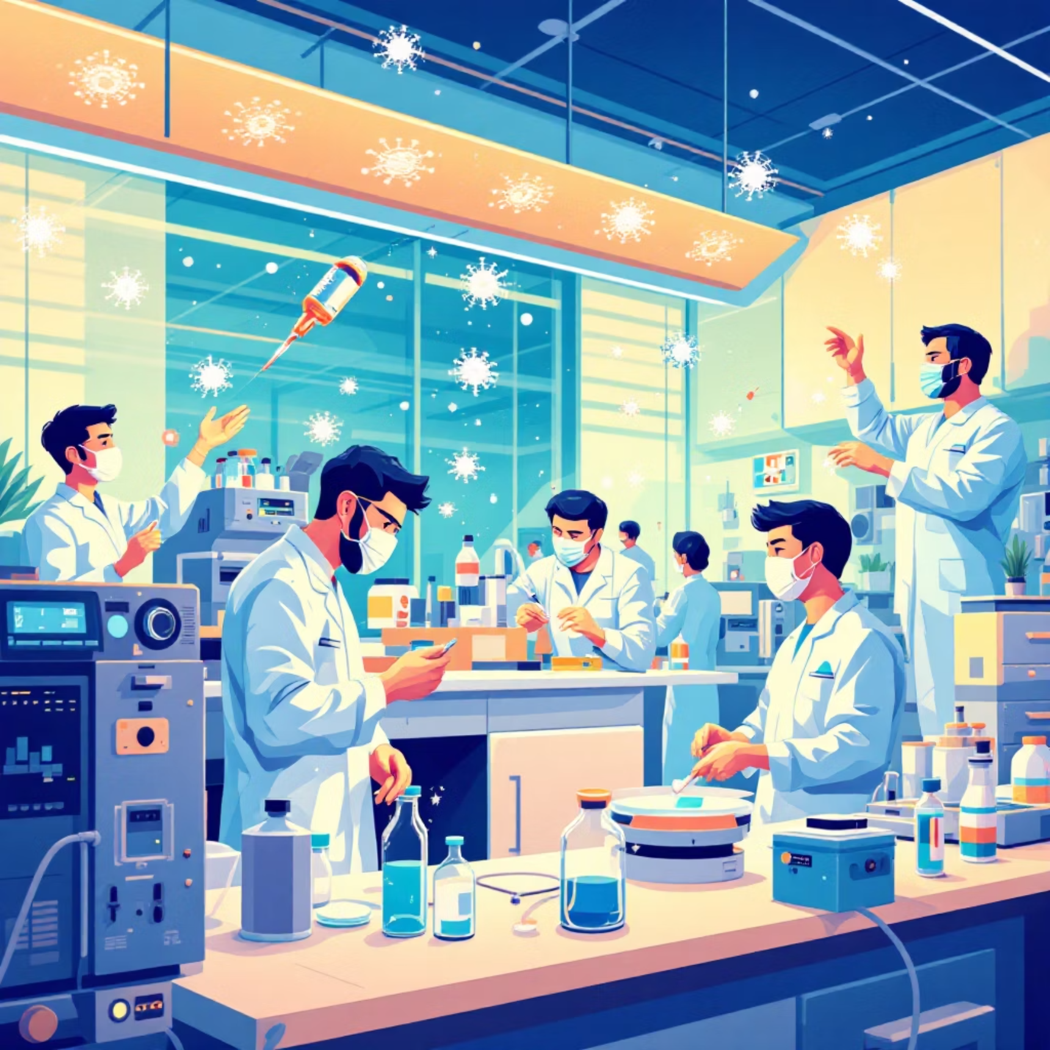
Step 3: Collaboration with Biotech
Biotech partners refine vaccines based on ML insights for rapid precision manufacturing.
Optimize antigen levels.
Adjust adjuvant type and dosage.
Modify delivery routes (IM vs ID vs SC)
This collaboration enables rapid precision vaccine manufacturing.

Slide 10
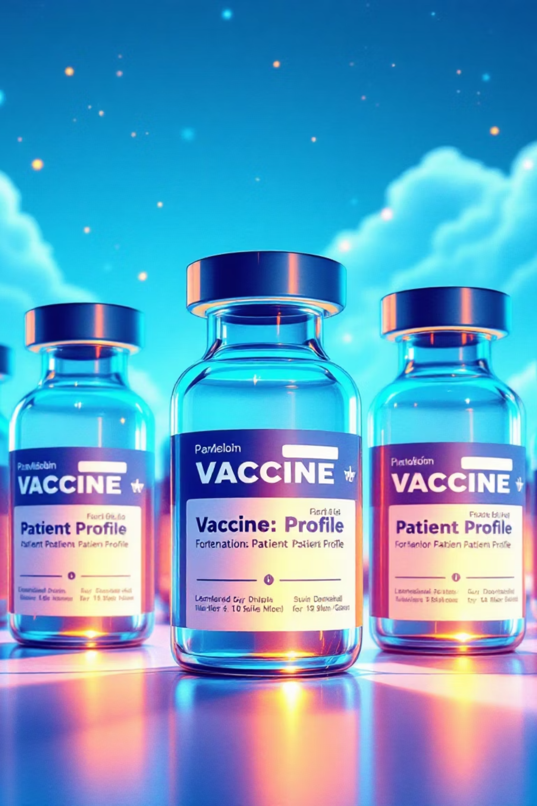
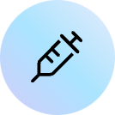
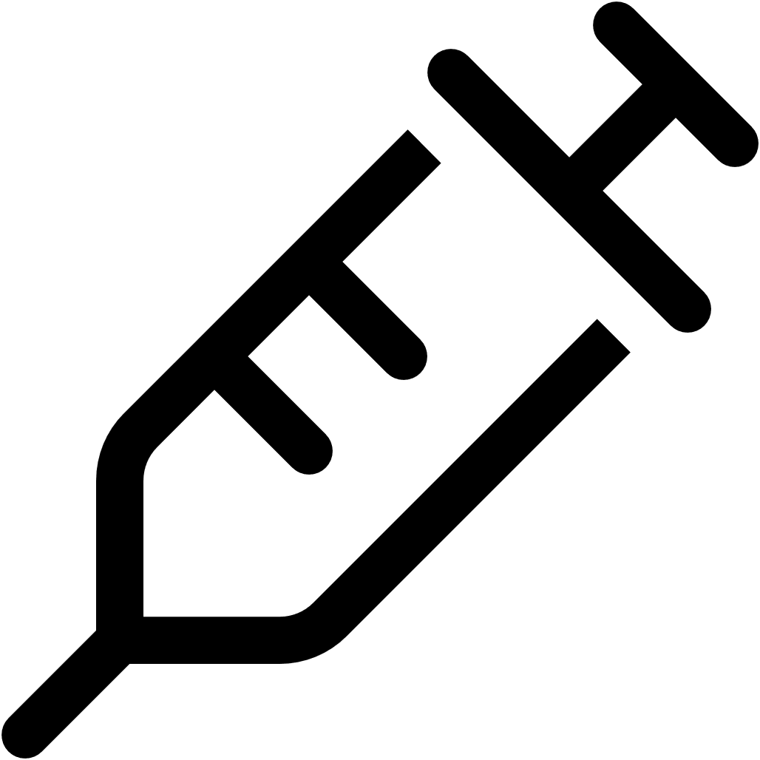


Final Output: Variant Formulations
The system produces standard and multiple variant formulations based on patient clusters.
Standard Vaccine
For normal responders.
Variant Formulations
Tailored for specific patient clusters.
Benefits:
Safer vaccination and higher immune protection.
Reduced adverse drug reactions (ADR).
Continuous improvement with new data.

Slide 11


Clinical Case Examples
Case 1: Complex Profile
Case 2: Healthy Individual
45-year-old male with diabetes and mild asthma.
25-year-old healthy athlete.
Previous moderate vaccine reaction.
No significant medical history.
Recommended: Modified vaccine + split dose (0.25mL → 72 hrs → 0.25mL).
Recommended: Standard dose, no modification needed.

Slide 12

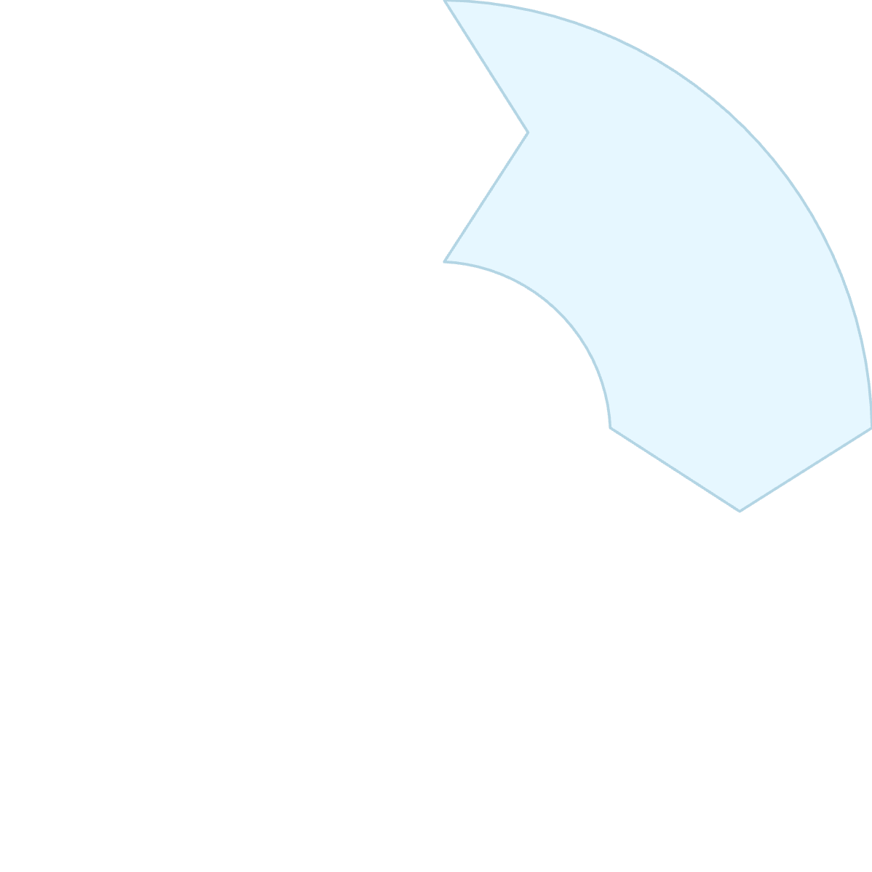






Vision & Future Impact
Vaccines Personalized
AI-Driven
Vaccines tailored to Different disease types.
Dosage, composition, and delivery optimized by AI.
Global Shift
Better Protection
A new era of precision immunization worldwide.
Enhanced safety for vulnerable populations.

Slide 13
Website
GitHub Repository
URL: https://lovable.dev/projects/37abb7f2-95b6-4c48-a606-fbb9ec6225cb

Slide 14
THANK YOU

